Slide 1

SAFRAN engineering services C++ programming under DO178 - 332

Slide 2
C++ programming under DO178 / DO332 Course organization
Planning |  |  | Teatcher | Content | Room
12/12/2017 | 10h15 | 12h15 | Manon | Presentation of DO178 / DO 332 Practical work on landing gear monitoring system | Caud07
12/12/2017 | 13h15 | 15h15 | Manon | Practical work on landing gear monitoring system specification | D202
19/12/2017 | 13h15 | 15h15 | Dupouy | Recall on C++ basics Zoom on DO 332 (review of main FAQ in DO332) | D202
19/12/2017 | 15h30 | 17h30 | Dupouy | Practical work on landing gear monitoring system class modelling / C++ coding / testing | D202
10/01/2018 | 10h15 | 12h15 | Dupouy | Practical work on landing gear monitoring system class modelling / C++ coding / testing | D203
10/01/2018 | 13h15 | 15h15 | Dupouy | Practical work on landing gear monitoring system class modelling / C++ coding / testing | D203
17/01/2018 | 10h15 | 12h15 | Dupouy | Practical work on landing gear monitoring system class modelling / C++ coding / testing | D205
17/01/2018 | 13h15 | 15h15 | Dupouy | Practical work on landing gear monitoring system class modelling / C++ coding / testing | D205
22/01/2018 | 10h15 | 12h15 | Dupouy | Practical work on landing gear monitoring system class modelling / C++ coding / testing | D205
22/01/2018 | 13h15 | 15h15 | Dupouy | Exam | D205

Slide 3
Objectives
Main pedagogical objectives:
To get acquainted with the basis of object coding for critical software
To be able to realize simple coding using C++
Detailed pedagogical objectives:
To get acquainted with critical software
To get acquainted with DO178C norm and related refinements
To get acquainted with DO178C process
To get acquainted with DO332
To get acquainted with the concept of Configuration management and Modification management
To get acquainted with the use of manual coding versus automatic coding

Slide 4
Work to be performed
Integration
and
System
System
specification
verification
Input
Sofware
Fonctionnal
specification
tests
LLR
specification
Unitary
tests
Work to be
performed
C
coding
Object
coding

Slide 5
Work to be performed
Work to be performed:
Write the LLR specification and the data dictionnary, trace with HLR, apply related check list
Write the class diagram, trace with LLR, apply related check list
Write the software using C++, trace with LLR, apply related check list
Write test cases, trace with LLR, apply related check list
Furnished document:
Software Requirements Specification (presented next)
Template of traceability matrix
Template of check list
Template of data dictionnary

Slide 6
Software Requirements Specification Extracts
SYSTEM OVERVIEW
The Landing Gear Monitoring System (LGMS) is composed of several functions.
One of these functions is the Brake Temperature Monitoring System (BTMS).
It is presented next:
Indication:
Displays brake temperatures to the flight and maintenance crew for information and fault diagnosis.
Warning:
Warns the flight crew that the brakes are at a temperature which could prevent a safe RTO being performed.
Warns the flight crew that the brakes are at a temperature which could ignite a flammable source (e.g hydraulic fluid).
Warns the flight crew that the brakes are at a temperature which could raise the bay temperature such that the bay structure and equipment in the wheel wells could be damaged.

Slide 7
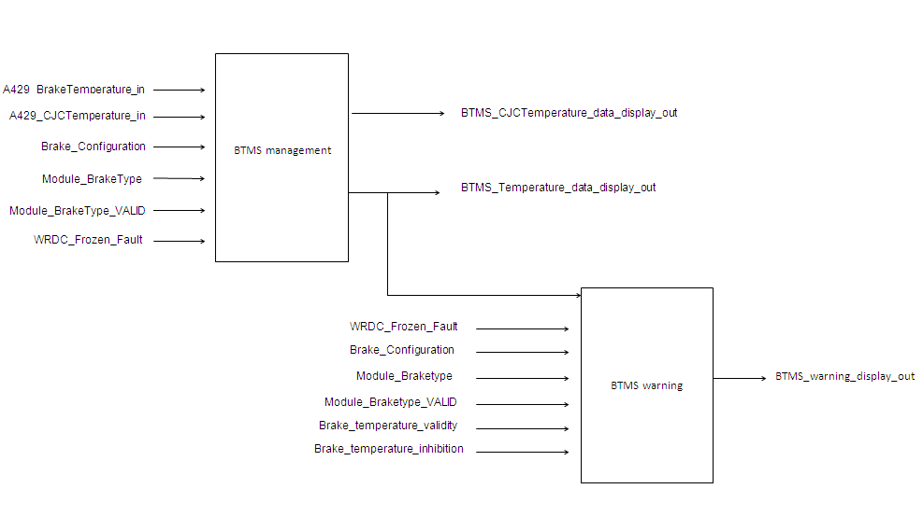
Software Requirements Specification Extracts
4 CJC temperatures
1 temperature for each wheel, total number of wheels : 12
WRDC : Wheel Remote Data Consentrator
External equipement which aim is to acquire transducers and send it to LGMS
Group of several data:
Hot Brake warning (1 to 12)
Any Brake Hot Warning
Hottest Brake Temperature (1 to 12)
Very_Hot_Brake_Wheel (1 to 12)

Slide 8
Software Requirements Specification Extracts BTMS transformations and indications
BTMS Management req
A350_LGMS_HLR_0037
[
The measured brake temperature range shall be [-55°C, +1100°C]. Outside this range, the output measured brake temperature shall be frozen to its last valid value and after a confirmation time of 9.6 seconds, the validity of the output measured Brake Temperature shall be set to FALSE if initially was TRUE. If the measured brake temperature comes back in the range [-55°C;1100°C] after a confirmation time of 9.6 seconds, the output measured brake temperature shall be set to the measured brake temperature and its output validity shall be set to the input validity.
]
A350_LGMS_HLR_0038
[
The CJC temperature received by the WRDC shall be [-55°C ; 150°C]. Outside this range, output cold junction Temperature value shall be frozen at its last valid value and after a confirmation time of 9.6 seconds, the output validity of cold junction Temperature shall be set to FALSE if initially was TRUE. If the CJC temperature comes back in the range [-55°C;150°C] after a confirmation time of 9.6 seconds, the output validity of cold junction temperature shall be set to input cold junction validity and output cold junction Temperature value shall be set to input cold junction temperature.
]

Slide 9
Software Requirements Specification Extracts BTMS Warnings
BTMS Warning req
A350_LGMS_HLR_0041
[
The partition shall compute the Hot Brake warning (contained in the BTMS_warning_display_out) for each braked wheel i (i= 01, 02,... 12) as following: - If the brake temperature rises above the brake temperature threshold (300 °C), the Brake_Hot_Wheel_i shall be set to "Active", - If the brake temperature falls 10°C below the threshold, the "Hot Brake warning" shall be set to "Inactive". The activation and deactivation of each bit are confirmed during 9.6 seconds. - If the brake temperature is between the 2 thresholds [Hot Temperature threshold; Hot Temperature threshold - 10], the LGMS OPER partition shall reset the confirmation time and keep the state of the hot brake warning.
]
A350_LGMS_HLR_0044
[
A global Any Brake Hot Warning shall be set to "Active" when one Hot Brake Warning is set to "Active". It shall be set to "Inactive" when all Hot Brake Warning are set to "Inactive".
]

Slide 10
Software Requirements Specification Extracts BTMS Warnings
BTMS Warning req
A350_LGMS_HLR_0045
[
For each wheel the Hottest Brake Temperature bit shall be set to "Active", Hottest_Brake_Wheel_i="Active", i= 01, 02,... 12, when all of the following conditions occur:
the measured brake temperature BrakeTemperature_Wheel_i is greater or equal to 100°C for the current wheel
the consolidated validity of the BrakeTemperature_Wheel_i is TRUE
the measured brake temperature BrakeTemperature_Wheel_i is greater than all the valid measured brake temperature for the other wheels For each wheel if the Hottest Brake Temperature bit have been set to "Active" - Hottest_Brake_Wheel_i = « Active » then the Hottest Brake Temperature bit shall be set to "Inactive", when one of the following conditions occur:
the measured brake temperature BrakeTemperature_Wheel_i is smaller than 100°C for the current wheel and the valisity of BrakeTemperature_Wheel_i is TRUE
the consolidated functional validity of FS_BrakeTemperature_Wheel_i is FALSE
the measured brake temperature is smaller than any other valid wheel
]
A350_LGMS_HLR_0122
[
When several wheels have the same measured brake temperature at cycle N, greater or equal to 100°C, and the Hottest Brake Temperature bit was already set to 'Active' for one of them at cycle N-1, then the Hottest Brake Temperature bit shall be kept for the wheel already set to 'Active'. When several wheels have the same measured brake temperature at cycle N, greater or equal to 100°C, and no Hottest Brake Temperature bit was set to 'Active' for one of them at cycle N-1, then the Hottest Brake Temperature bit shall be set to 'Active' for the wheel with the smallest index.
]

Slide 11
Software Requirements Specification Extracts BTMS Warnings
BTMS Warning req
A350_LGMS_HLR_0149
[
The partition shall set the Very Hot Brake parameters to « Active » for each braked wheel, Very_Hot_Brake_Wheel_i="Active", i= 01, 02,... 12, if the temperature of brake for this wheel rises above 800°C. It shall set the « Very hot Brake parameters » to "Inactive" when the temperature for this wheel falls below 790°C. The activation and deactivation of each parameters are confirmed during 9.6s. If the temperature of brake for this wheel is between [790°C;800°C], the LGMS OPER partition reset the confirmation time and keep the state of the very hot brake parameters as it is. Note : To alert the maintenance crew of the very hot brake temperature - and therefore potential damage to the axle.
]

Slide 12
Powered by trust : la confiance est notre moteur
Safran Engineering Services/ Confidentiel / Juin 2016/ Commerce

